Slide 1
Marketing Campaign Analysis for a Banking Institution

Slide 2
Introduction
This project evaluates the effectiveness of phone-based marketing campaigns by a Portuguese bank to increase term deposit subscriptions.
Our team’s objective is to perform data-driven analyses to evaluate campaign effectiveness.
Key tasks include data preparation, exploratory data analysis (EDA), and business intelligence dashboard creation.
The analysis aims to identify customer behavior patterns and campaign performance metrics.
Insights from the study will guide actionable recommendations to enhance future campaign strategies.

Slide 3
Overview Of Data
Dataset Summary: Consists of [total rows] records and [total columns] attributes related to customer demographics, financial status, and campaign interactions.
Data Types: Includes both categorical variables (e.g., job, marital, education) and numerical variables (e.g., age, balance, duration).
Missing Values and Duplicates: Certain columns contain missing or unknown values that need handling and there is no any duplicate.
Target Variable: y (binary) indicates whether the customer subscribed to a term deposit.
Data Preparation Focus: Addressing missing values, encoding categorical variables, and ensuring data quality for analysis.

Slide 4

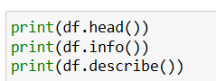
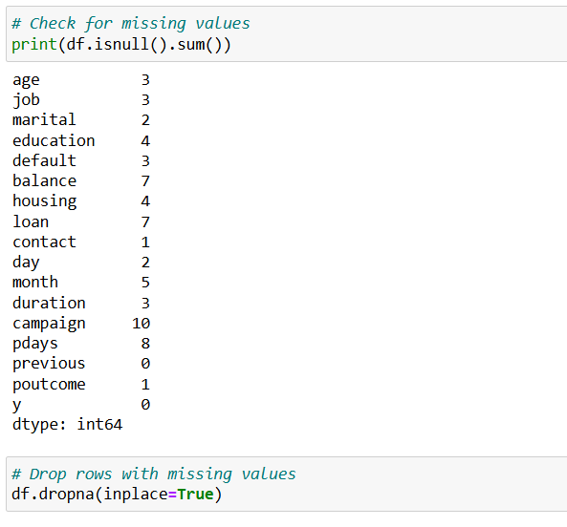
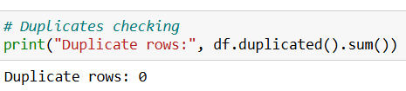


Data Preparation
Data cleaning stepsa are mentioned below.
Import Required Libraries:
Load the Dataset:
Inspect the Dataset:
Handle Missing Values:
Remove Duplicates:
Handle Categorical Variables:
Save the Cleaned Dataset:
Verify the Cleaned Data:

Slide 5
Exploratory Data Analysis (EDA)
Through EDA we uncover trends, relationships, and anomalies in dataset which can inform further analysis and decision-making. This are;
Age distribution. The dataset includes a wide age range of 30sto 60s. this could indicate a mature target market for financial products
2. Job roles. The distribution of Job roles indicates that the bank may need to tailor its marketing strategies for different professional backgrounds.
Other factors to consider include marital status, educational levels, financial health, loan and housing status, contact method effectiveness, campaign performance, and outcome analysis.

Slide 6
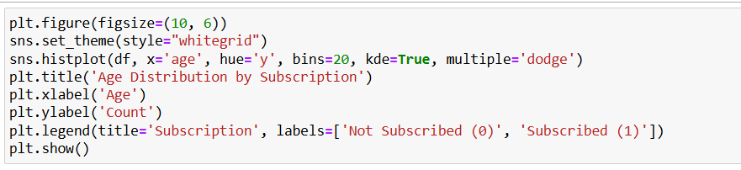
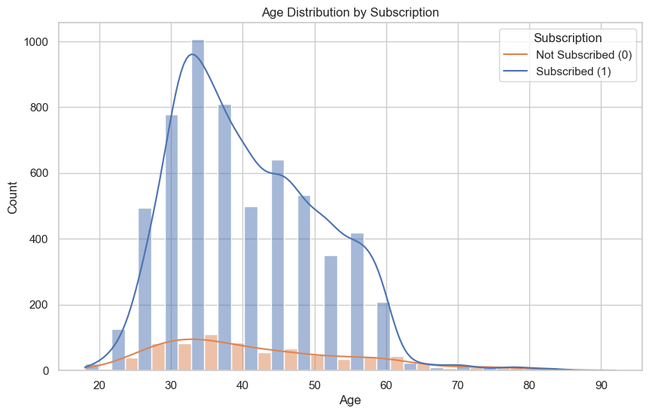
Visualization (Age Distribution by Subscription)
Age distribution by subscription" refers to analyzing the spread of different age groups within subscribed and unsubscribed customer segments.
This helps identify which age groups are more likely to subscribe to a service or product
For example: A histogram or density plot can show the count of subscribers and non-subscribers across age ranges.
Visual tools (like histograms with "Subscribed" and "Not Subscribed" categories) make it easy to compare age-based trends in subscription data.

Slide 7
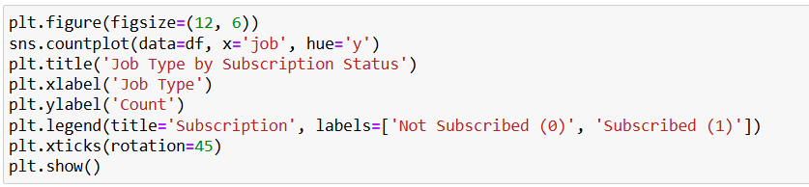
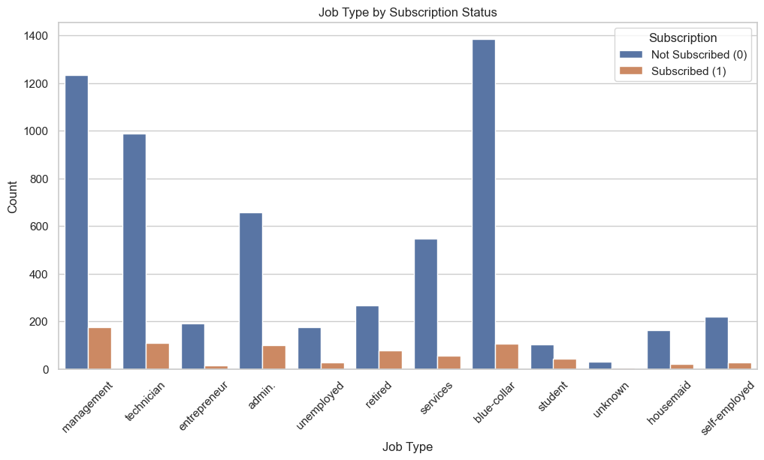
Visualization (Job Type by Subscription)
Job type by subscription status examines how employment type (e.g., student, employed, retired) influences likelihood of subscribing to products.
This bar chart shows the distribution of subscription status by job type. The x-axis represents various job types (like management, technician, entrepreneur, etc.), while the y-axis shows the count of people in each job type.

Slide 8
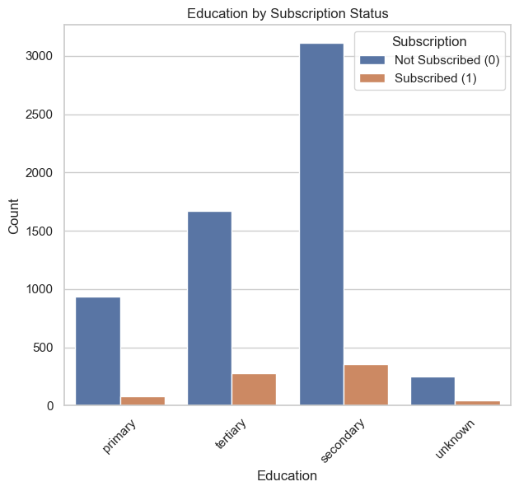
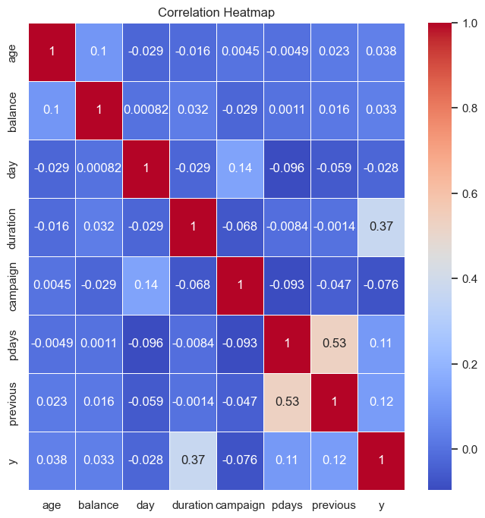
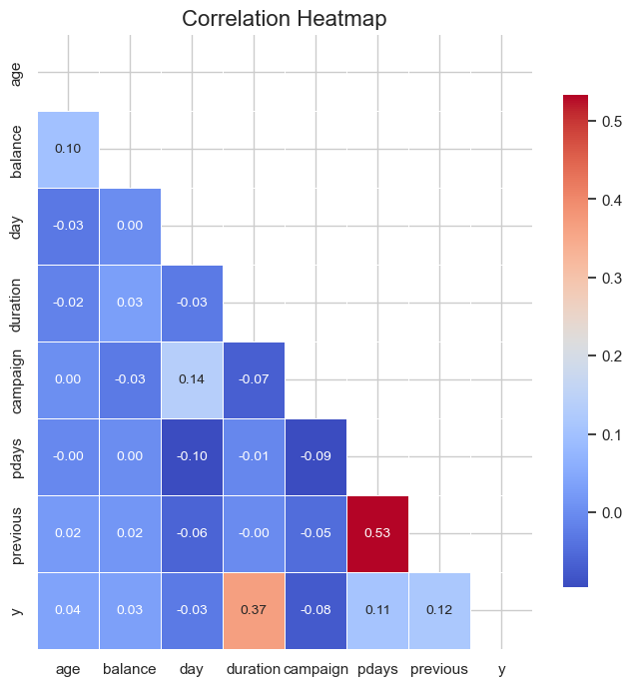
Visualization (Education by Subscription) and Heatmap
Education by Subscription: This chart shows the relationship between educational levels and the likelihood of subscription to term deposits, illustrating patterns in customer demographics.
Heatmap:A graphical representation using colors to display correlation values between variables, helping identify relationships and trends within the data.

Slide 9
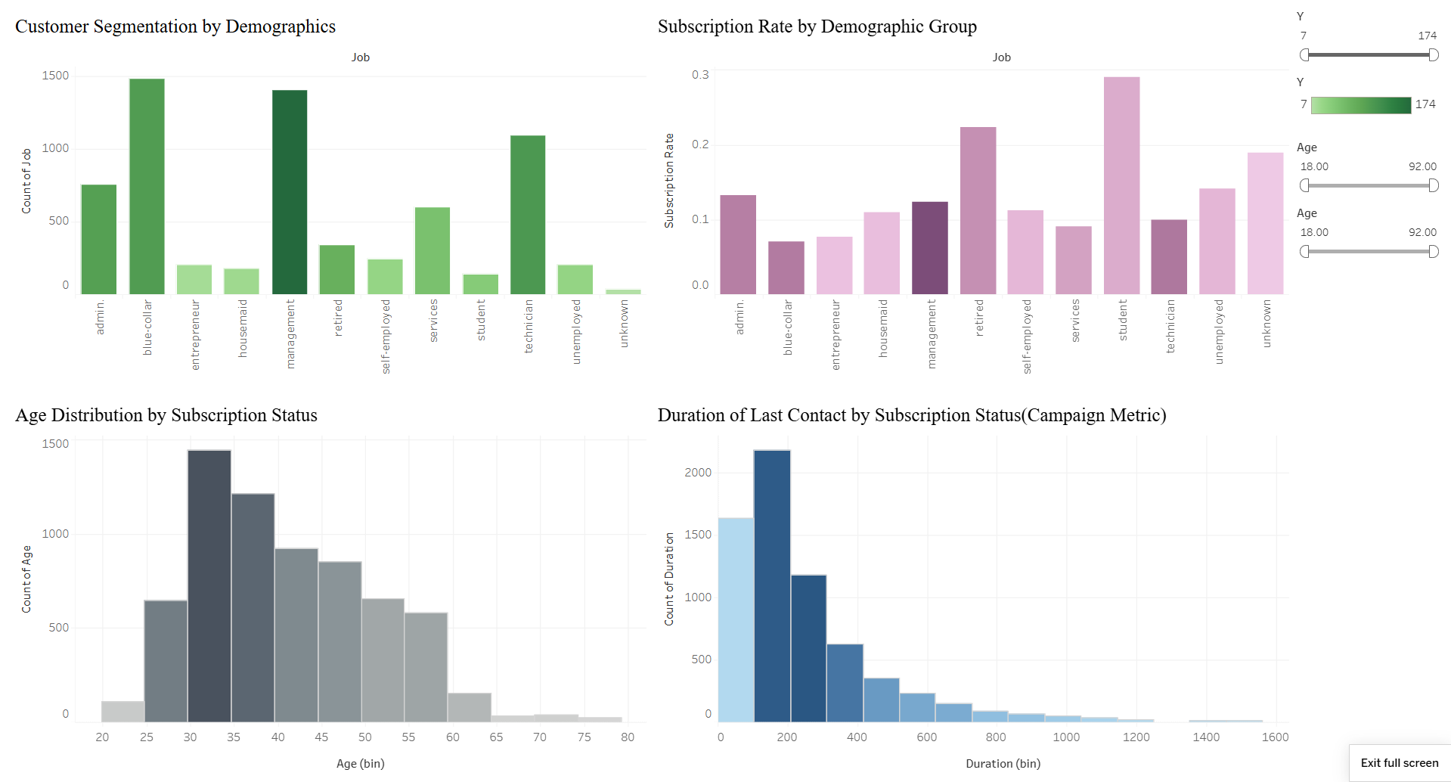
Tableau Dashboard
The dashboard highlights key insights into customer demographics, subscription rates, and campaign performance.
It shows that job type and age influence subscription rates, with students and retirees showing higher interest.
Longer call durations correlate with higher subscription success.
The filters allow for targeted analysis of customer segments.

Slide 10
Recommendations for Marketing Strategy
Focus on demographics with higher subscription rates, such as students and retirees.
Since longer call durations seem to result in more subscriptions, train agents to engage meaningfully during calls and address customer concerns thoroughly to increase conversion.
Create customized campaigns for different job categories. For instance, blue-collar and management positions might respond better to different messaging or offers based on their unique profiles.
Age groups show distinct subscription trends, so age-targeted marketing could be effective. Younger groups might prefer digital channels, while older segments might respond better to personalized calls.
Use the insights on successful campaign metrics to determine ideal follow-up frequency and timing, focusing efforts on the most receptive segments.

